Slide 1
General Body Meeting
OSINT and General Privacy

Slide 2
Learning Objectives
Passive VS Active
Ways to gather OSINT
OSINT Tools

Slide 3
Active VS Passive
https://github.com/kris-nova/boopkit

Slide 4
Personal Security

Slide 5
What’s the goal?
Still have a usable browser
Daily use but still protect our privacy, and security
Create something even our parents can do

Slide 6
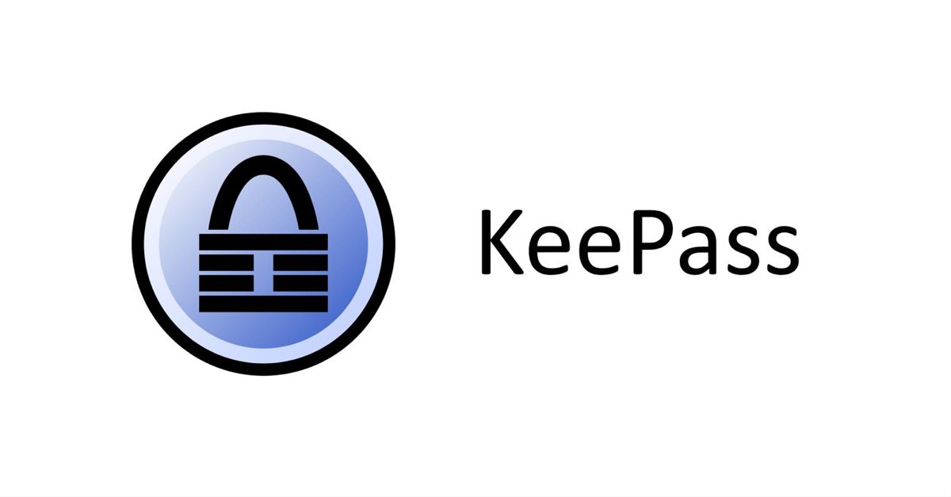

Authentication
Use a password manager
LastPass
KeyPass - Open Source
Bitwarden - Self Hosted
Use long passwords over complex
Harder to break a passphrase Vs Complex password
Multi-Factor Authentication!!!
Store backup keys on USB or on Paper
Seperate from password manager
Sign up for HaveIBeenPwned

Slide 7
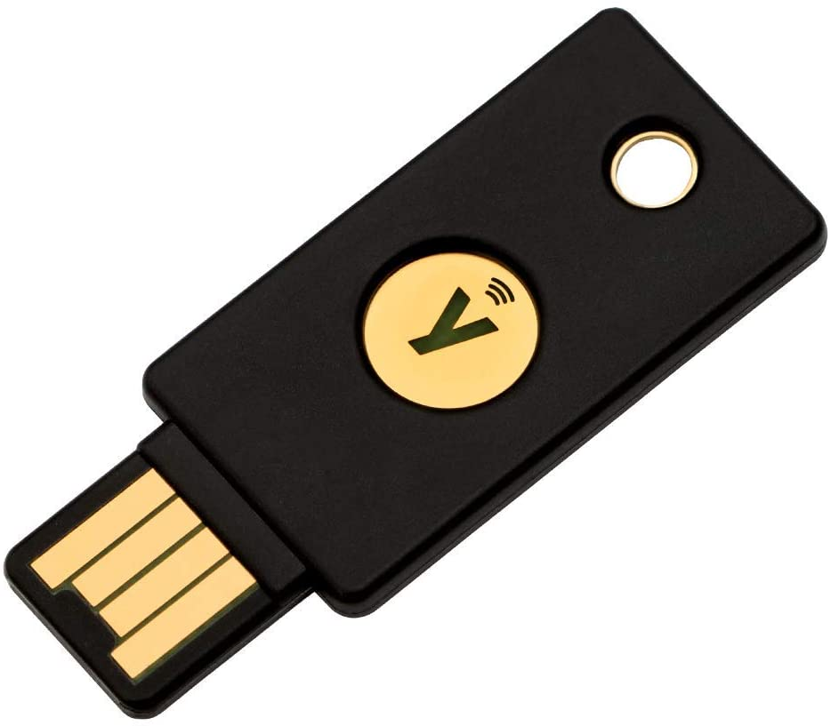
Hardware Tokens
Physical form of multifactor authentication
Hardware nature makes it resistant to phishing attacks etc.
Simple to utilize, comes in different formats
NFC, USB, SecurID

Slide 8


Browsers
Find a browser that respects your privacy
Firefox
DuckDuckGo
Brave?
Important Practices
No Autofill
Don’t login to your browser
Important Extensions
HTTPS Everywhere
uBlock Origin (Stronger Adblock)
Firefox Containers
Decentraleyes - CDN
Don’t use any unnecessary extensions
Honey (Coupons)

Slide 9
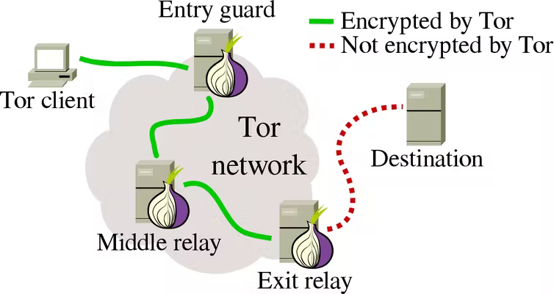
Tor?
Very useful for semi-anonymous browsing
Broke by Gov’t Agencies & Big Corps
Still a useful tool - Not for daily use

Slide 10
Phones
Use a pin or password & Encrypt your device!!!
Avoid FaceID if you do something sus
Android: Settings --> Security --> Encryption
IOS: Settings --> TouchID & Passcode --> Data Protection
Do your updates!
Remember to monitor App Permissions - You’re being tracked but block as much as possible
Forget public wifi when you’re done with it
Watch your location tracking - Its gonna be done, block as much as possible
Android: Maps --> Settings --> Location History
IOS: Settings --> Privacy --> Location Services --> System Services --> Places
App Firewalls are powerful
NetGuard
Lockdown
USE SIGNAL!!!

Slide 11
Email
Watch out for Phishing & Spear Phishing
Email blocklist, known senders, check domains
Use Strong Auth so you don’t get popped, email can compromise other accounts
Consider separate encrypted mailbox: Protonmail, Tutanota
Alias your inbox - Protect your real address, see where leaks come from
Use a + at the end: John+amazon@gmail.com
Anonaddy or SimpleLogin
Disable automatic loading of remote content, HTML == JS == Bad
Consider custom domain so you hold your data
Leads to other considerations

Slide 12
Secure Communications
PLEASE use Signal & avoid WhatsApp & SMS
open source and end-to-end encrypted with perfect forward secrecy
Secure end devices, no cloud services if possible
Strip metadata from media before sharing
Verify your recipient & That it doesn’t change during comms
Find a stable, maintained, and trusted platform
Watch out for comms over TOR
Timing attacks

Slide 13
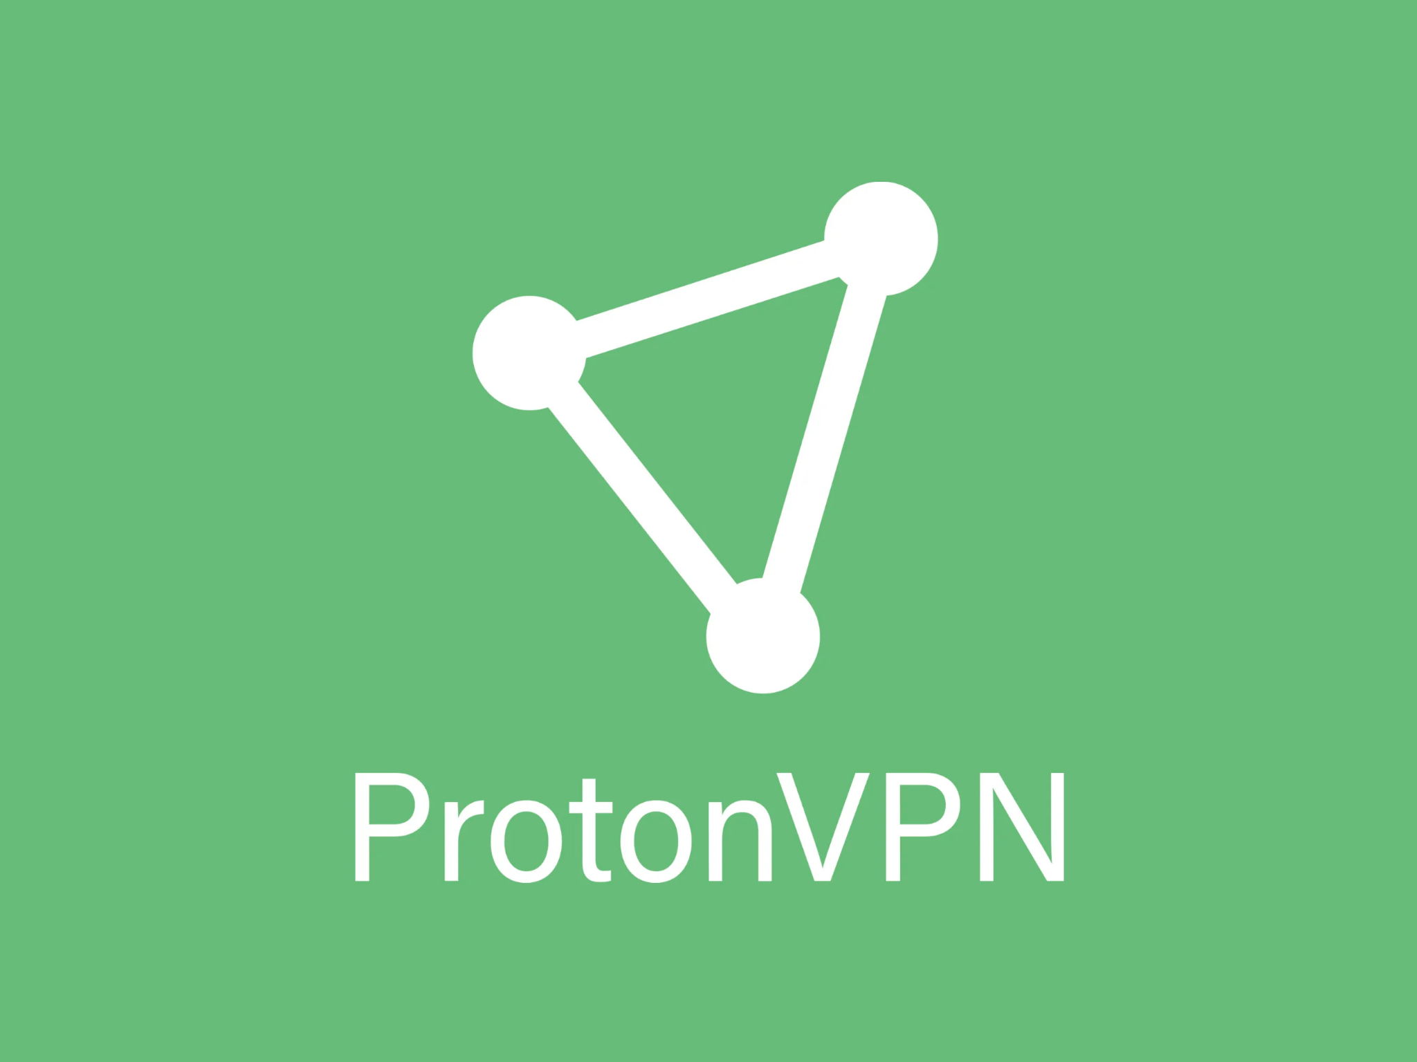
Networks & VPNs
Be careful with VPNs!
Reputable: ProtonVPN, Mullvad
Check into thatoneprivacysite.net
Change your router’s default password
Use WPA2/3 AES or equivalent as security for wireless networks (WPA3 Open)
Configure Secure DNS Provider: At router level or devices. Block External DNS
Pi Hole
Quad9: 9.9.9.9
Cloudflare: 1.1.1.1

Slide 14
How to secure yourself - Resources
GitHub - Lissy93/personal-security-checklist

Slide 15
OpSec

Slide 16
Computer Fraud and Abuse Act of 1986 (CFAA)
Punishable by up to five years in prison each (ten years for repeat offenses), plus fines.
Violations of other parts of the CFAA are punishable by up to ten years, 20 years, and even life in prison.
What you learn here will not help you avoid time in prison

Slide 17
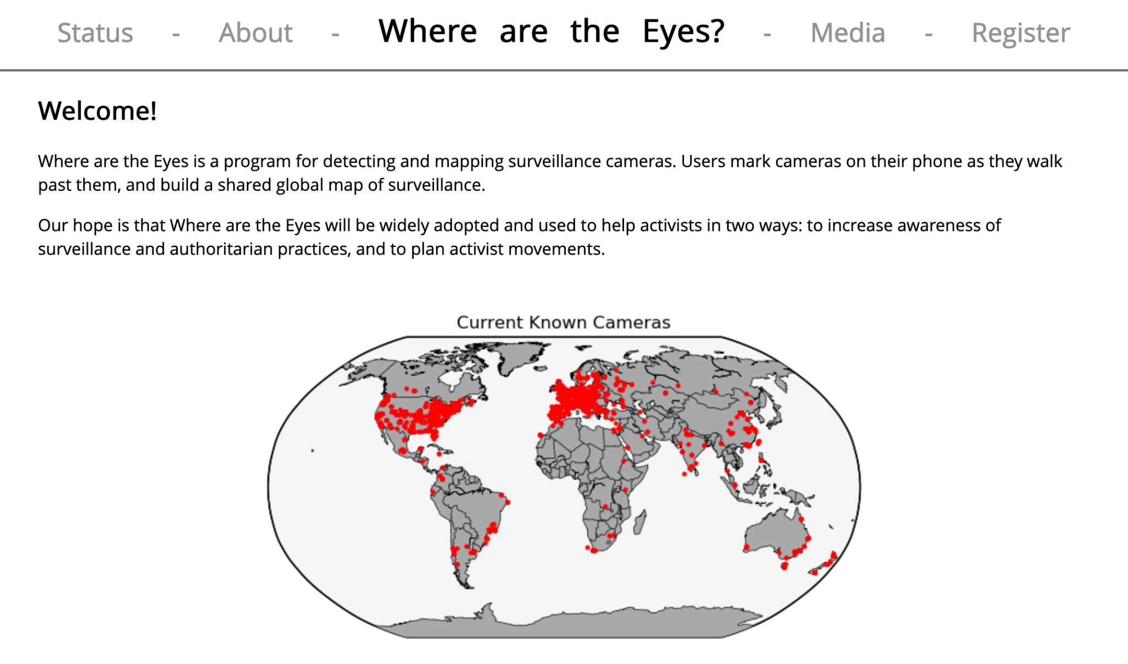
Surveillance

Slide 18
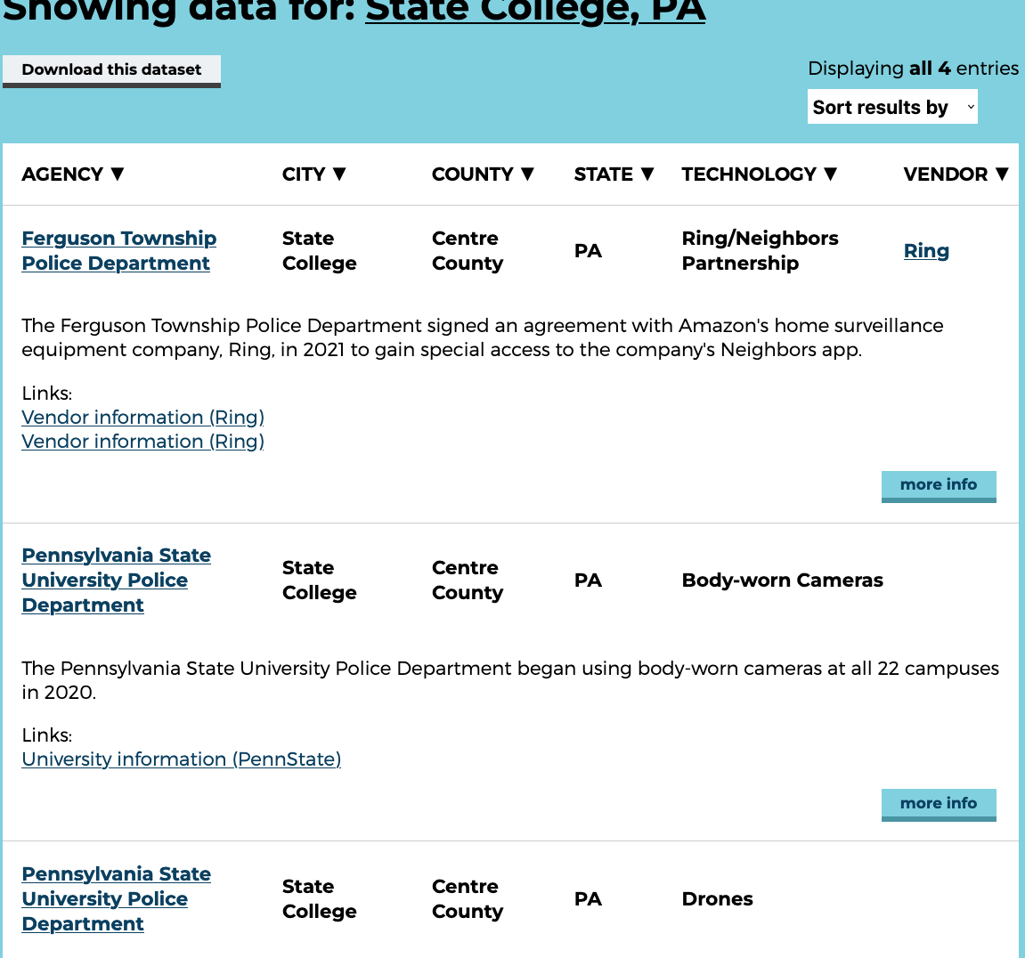
Surveillance Cont.

Slide 19
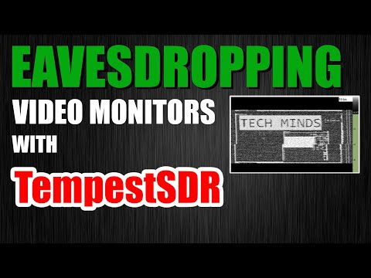
Surveillance Cont.

Slide 20
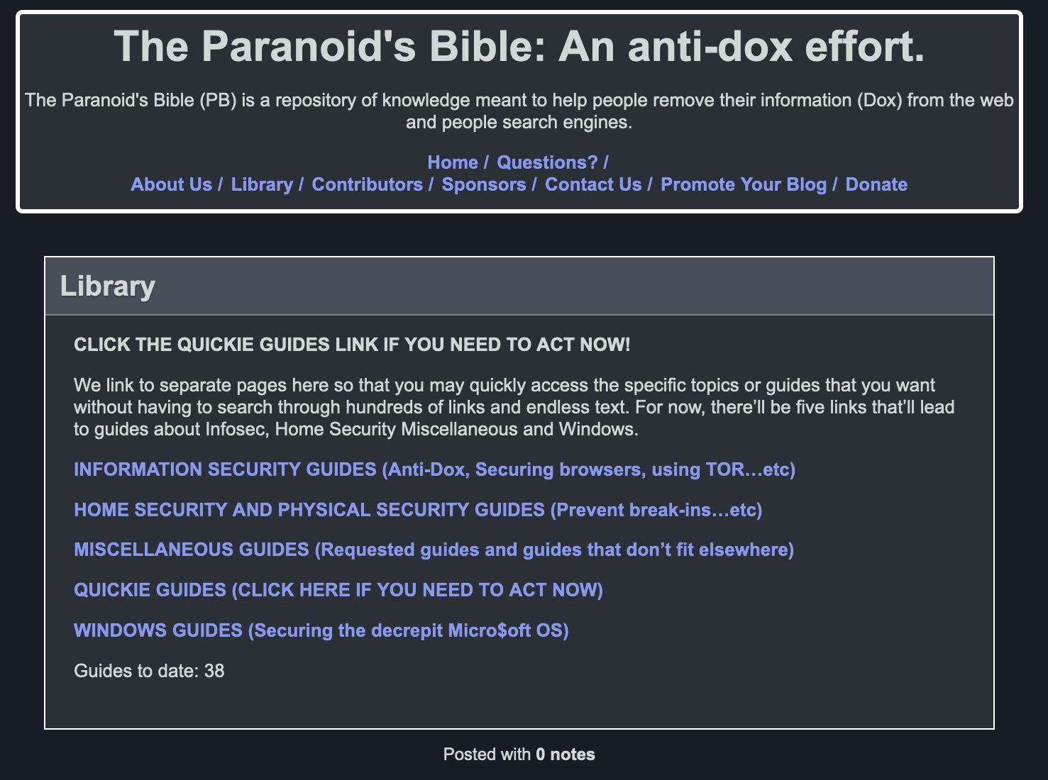
Protection
https://paranoidsbible.tumblr.com/library

Slide 21

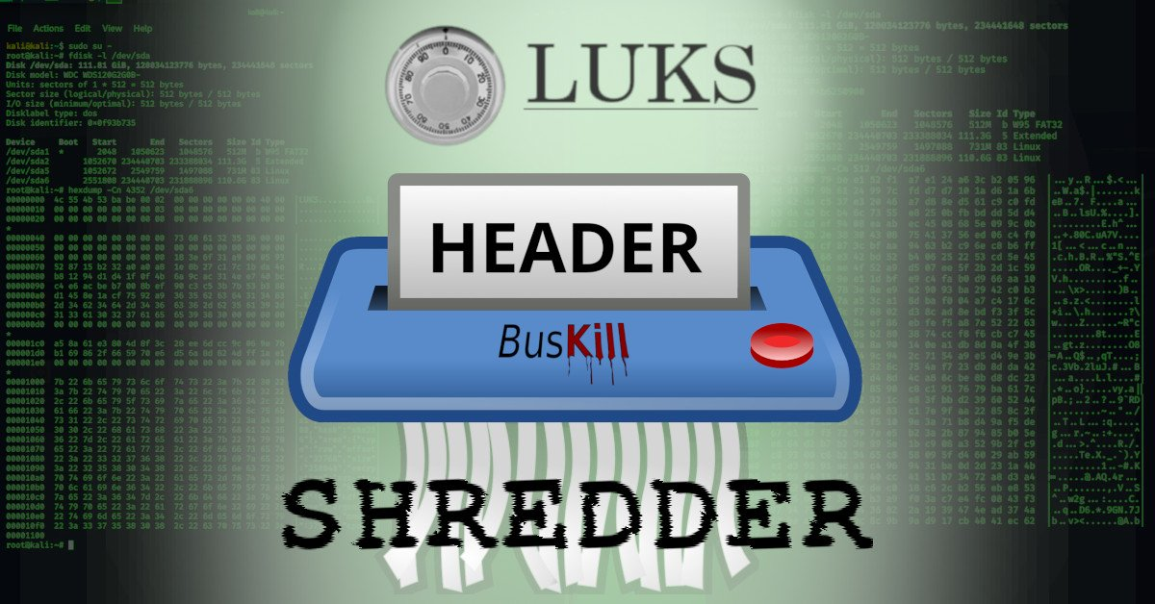
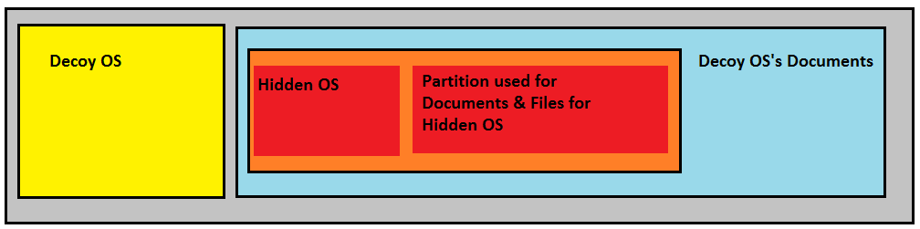
Disk Encryption
FULL DISK ENCRYPTION - Veracrypt or LUKS
Deniability key
LUKS HEADER NUKE: https://www.kali.org/blog/nuke-kali-linux-luks/
VERACRYPT Hidden OS: https://veracrypt.eu/en/docs/hidden-operating-system/
Use strong cascade algorithm - AES-Twofish-Serpent or Serpent-Twofish-AES
Use decoy OS - Strange encrypted laptop is suspicious
Can be tied to a hardware token

Slide 22
IPTables & UFW
Firewall rules are super important
Prevent data leakage
Prevent Shells from being spawned
Prevent communication you don’t allow
https://github.com/trimstray/iptables-essentials
Similar to UFW without the wrapper
DEFAULT DENY

Slide 23
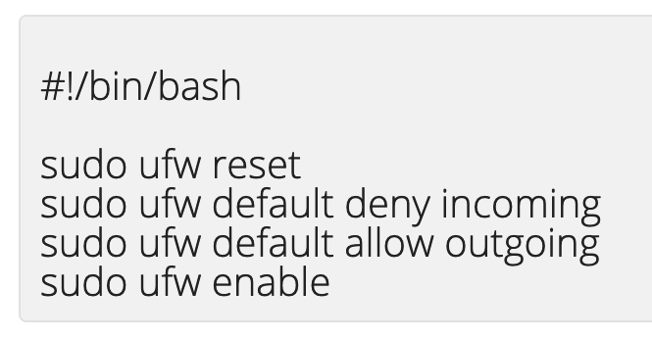
VPN & Tor & Killswitch
All traffic should flow in though your anonymized connection
VPN To country outside US!!! CFAA
Usually looks like HOST > VPN > TOR
Proxies & Jump-boxes can fit in here as well
QuebesOS = Host Isolation
Tails = Host Based Tor
Whonix = Split VM less host leakage
Complicated == Bad

Slide 24
There’s always a leak
These are more considerations to take when you conduct an operation:
Your habits, the times of day you hack, the device you hack from, the wireless networks you use, personal phone screen time, location data, bluetooth IDs, MAC Addresses, Security Logs, money used to buy assets, Communication habits, RECON leaks.
They have more money then you do and will play dirty. Don’t get caught doing something stupid

Slide 25
Questions?

